Slide 1
Toy Cars and Collisions James Fiorini, Mechanical Engineering St. Xavier High School, Senior Physics
RET is funded by the National Science Foundation, grant # EEC-1404766
Mechanical Engineering Major
Minor in German
Offered COFSP
Interested in the leadership aspect
St. Xavier High School
Jesuit Private School in Finneytown
Range of kids from different areas
I worked with the Senior Physics Classes
Three classes total, from 24-27 students each

Slide 2
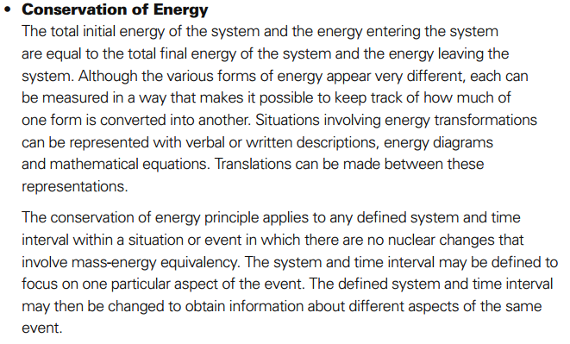
Conservation of Energy
Personal Capstone:
Involvement with airdrop system
Energy across systems
Topics in the Classroom:
Energy Conservation
Collisions
Both include:
Connection and separation of bodies
Energy conservation
Speed
Standards to meet:
St. Xavier Outcomes for Physics, similar to Ohio Department of Education New Learning Standards

Slide 3
Activity on Collisions - Objectives and Guiding Questions
Objectives:
The student will be able to:
Identify inelastic and elastic collisions
Recognize the difference between collision types
Solve practical problems using:
P = mv
Law of conservation of momentum
1- and 2-dimensional particles
Guiding Questions
What is a collision? What are the characteristics of a collision?
What real-world purpose does this serve?
How can I identify different types of collisions?
How can I change one collision to another?
What are the pros and cons to different collisions?

Slide 4
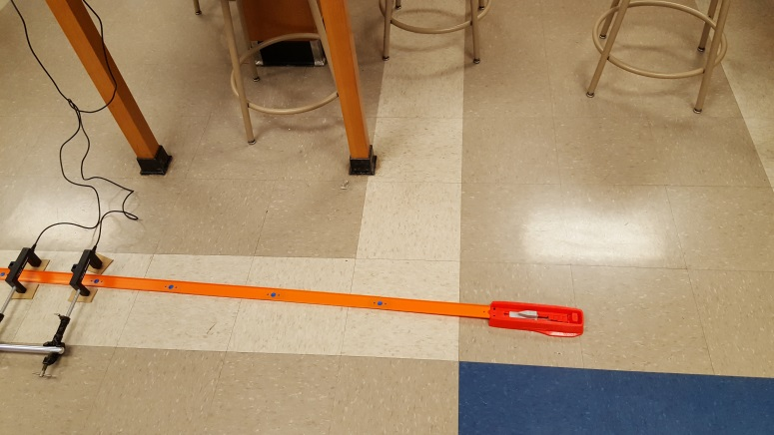
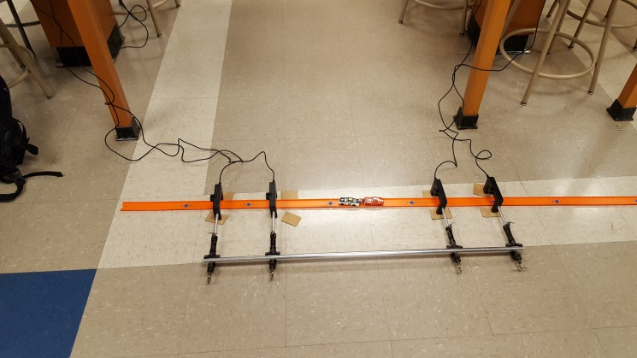
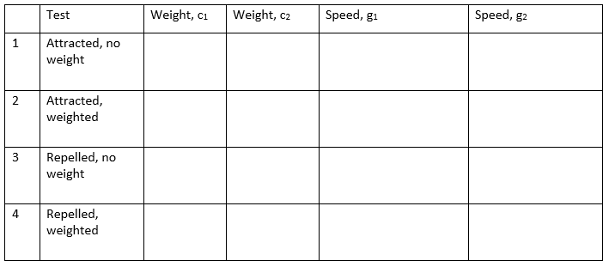
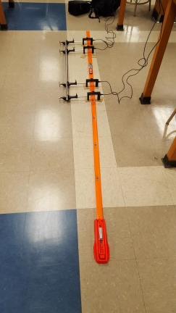
Activities
Four test tracks, four groups
Two cars, two photogate series, two strong magnets, many weaker ones for weights, tape, and project worksheet
Weights of cars taken
Four tests executed:
Car is launched, initial speed measured through first photogate
Second photogate measures speed of second car or both cars, depending on collision type
Worksheet reviews topics covered in lab

Slide 5
ACS: Application, Career, and Societal Impact
Application:
Using equations to model energy conservation
Seeing the changes in velocity as they happen
Effect of changes in mass and initial speed in the system
Career:
Understanding of energy and impacts
The activity taught valuable skills such as measuring and analysis used in careers such as engineering, research, and other problem-solving fields
Society:
Students developed problem-solving skills and scientific approaches to everyday problems through this lab, one example being trouble-shooting the photogates, and using phones and rulers to fulfill the same purpose

Slide 6
Results of assessment
Class 1
Least effective pre-lesson from me
Did not explain purpose of magnets well enough
Failure of photogates
Highest initial average, lowest total improvement
Class 2
Most eager class (also most energetic, but had no issues)
Effectiveness of magnets still not effectively communicated
Most improvement, but lower initial average than class 1
Class 3
My lesson was most improved, yet magnets still a problem area
Initial average lower than both classes, as well as final average, but greater improvement than Class 1
Class | Initial Average | Final Average
Class 1 | 4.19 | 4.42
Class 2 | 3.91 | 4.57
Class 3 | 3.81 | 4.30

Slide 7
Reflections
Even with pre-testing supplies, still prepare for equipment failures
Instead of photogates, phone video and stretch of track used
Greater focus on problem areas
Magnets: better understanding of student misunderstandings needed
Consistent Engagement
When students CAN work, they WILL work, and happily/productively
Students were engaged entire lab
Simple but flexible equipment
Outside of Photogates, the equipment for the project was simple
Students could choose cars, troubleshoot ideas, and vary strength of car launch
Enough constraints to keep students on path, enough freedom to allow creativity

